Slide 1


Week 1
1

Slide 2
Index
2
Sr no | index
1 | Week1Sketch1
2 | Week1Sketch2
3 | Week1Assignment
3 | Week1Assignment2
Sr. no
1
2
3
4
5
Contents
Week1Sketch1
Week1Sketch2 Week1Assignment1
Week1Assignment2 Insights

Slide 3
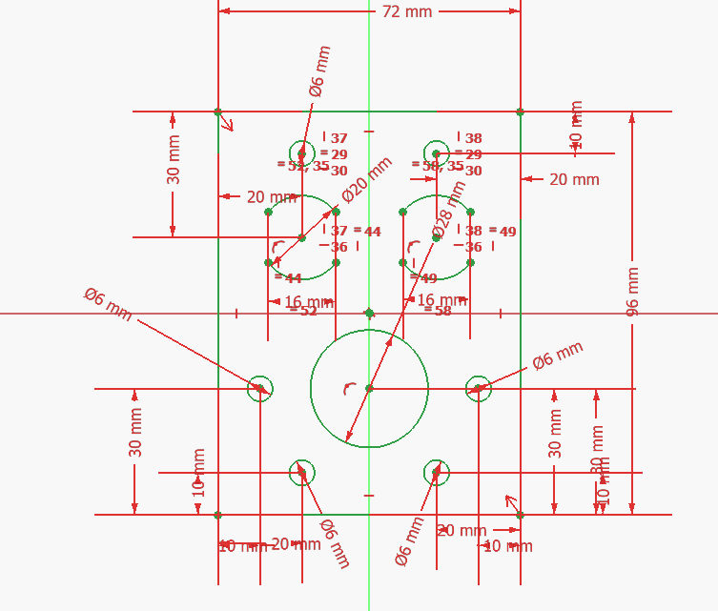
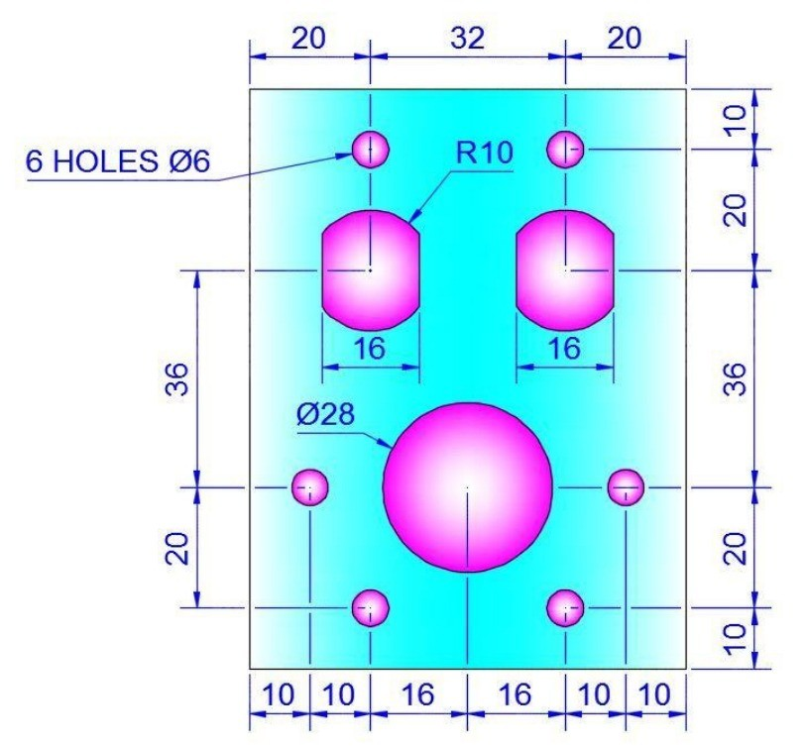
Week1Sketch1
3

Slide 4
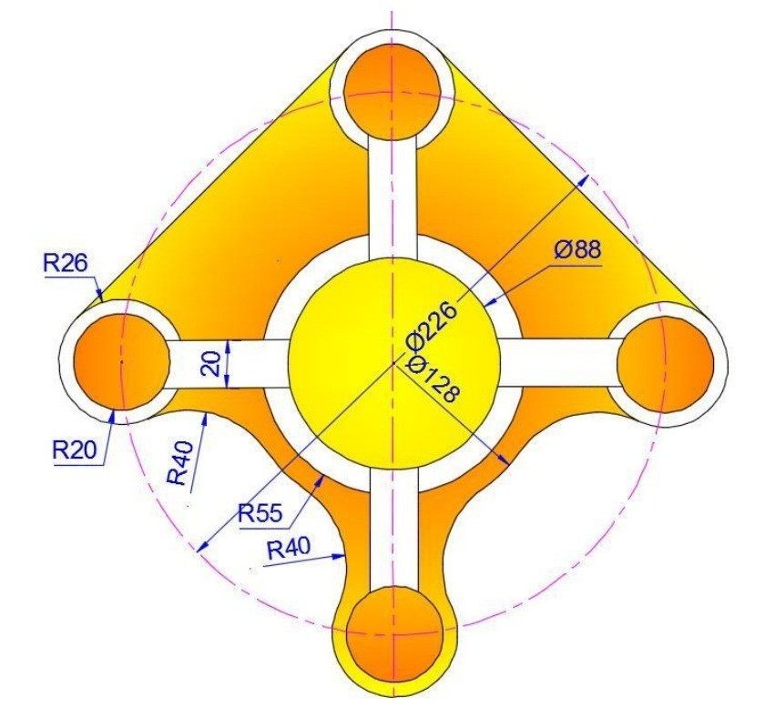
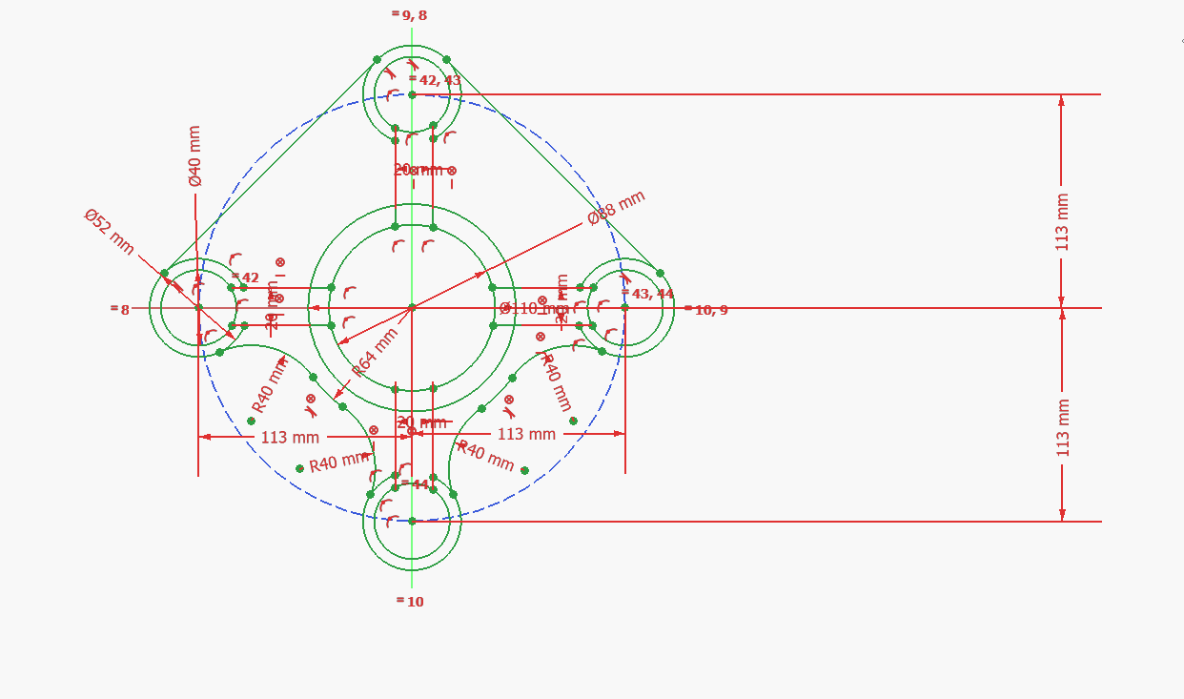
Week1Sketch2
3

Slide 5
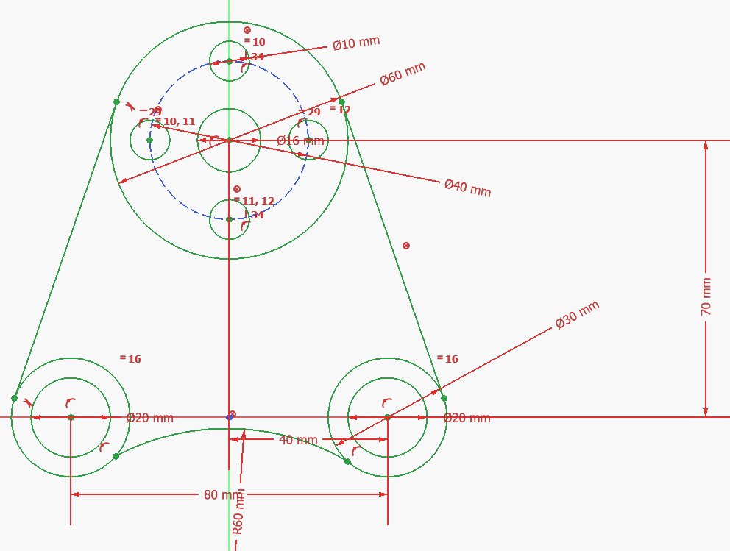
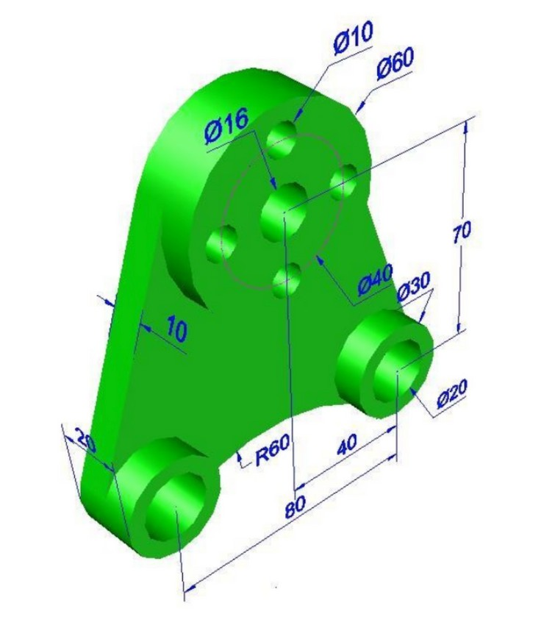
Week1Assignment2
3

Slide 6
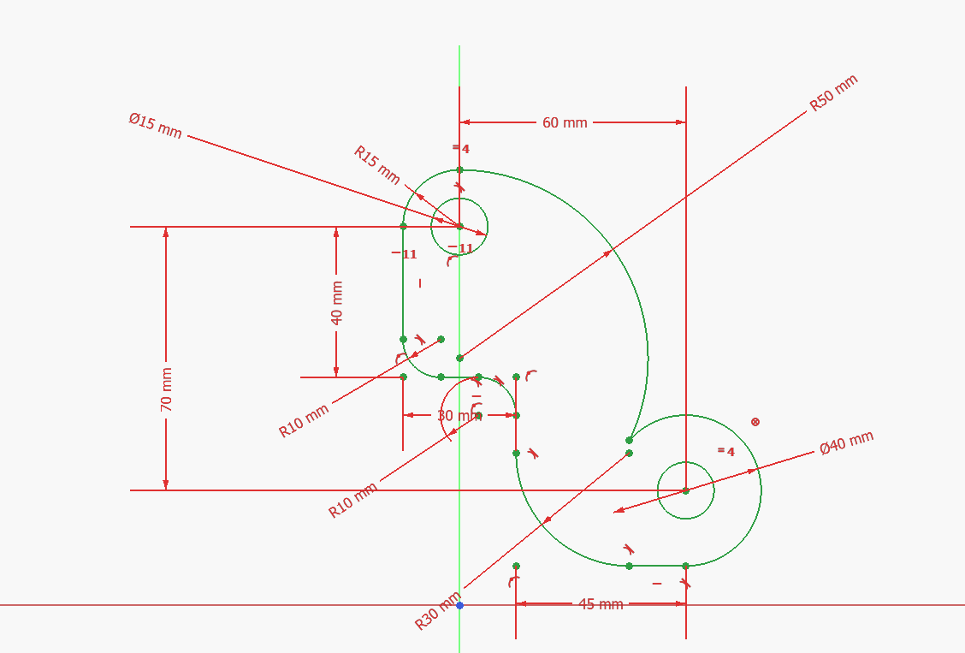
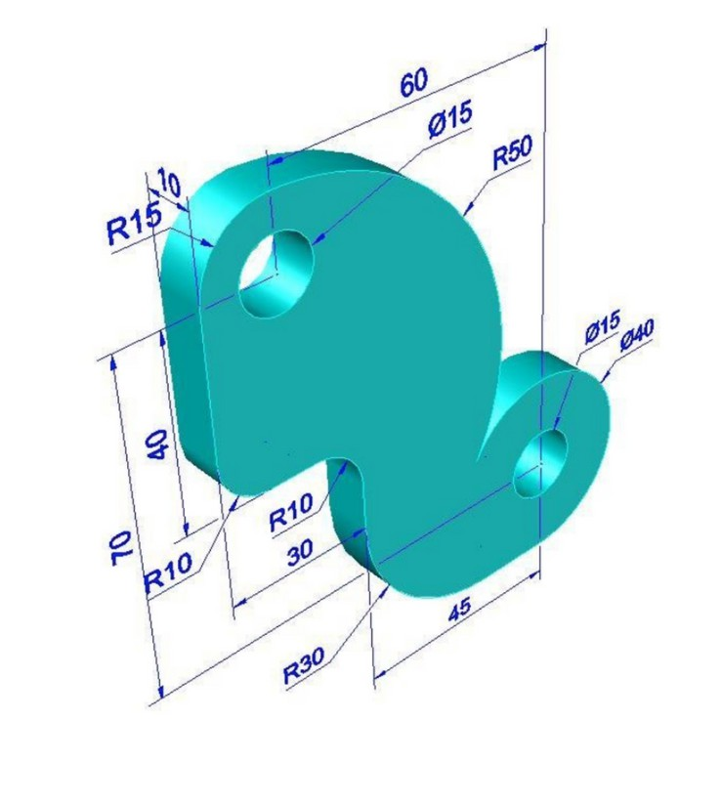
Week1Assignment2
3

